Slide 1
B.TECH PROJECT | SOFTWARE REQUIREMENTS SPECIFICATION
Retail Inventory
Management System
Modules and functionality of the Retail Command Center (Shopluxe)
Tanmay Garg
Roll No: 2400321540200 | CSE (Data Science)
ABES Engineering College, Ghaziabad | Guide: Avinay Raj

Slide 2
Project Overview
Retailers with several warehouses need to know what stock they hold, where it is, what is already promised to customers and what must be reordered. Spreadsheets and disconnected tools go stale quickly. The Retail Command Center solves this with one web platform backed by a single relational database.
11
4
Software modules
User roles + guest
15
48
Out of scope: mobile apps, AI demand forecasting, ERP / accounting integration, live payment or carrier integration.
Agile sprints
Test cases (TC01-TC48)
PRESENTATION
React + TypeScript, Axios, Recharts
APPLICATION
Spring Boot 3.2 REST, Spring Security + JWT
DATA
PostgreSQL via Spring Data JPA (rism_db)
Retail Inventory Management System | Shopluxe
2

Slide 3
Proposed Solution
From scattered records to one trusted source of stock information.
TODAY: THE PROBLEM
PROPOSED: RETAIL COMMAND CENTER
Stock kept in spreadsheets and registers
Data goes stale; people see different numbers
Manual entry causes errors
Reorders are noticed too late
One web platform on a single PostgreSQL database
Automatic stock reservation and low-stock alerts
Role-based portals for admin, supplier and customer
Dashboard and CSV reports from any browser
Single source of truth
Fewer manual errors
Faster stock and order status
Timely reorder alerts
Retail Inventory Management System | Shopluxe
3

Slide 4
Technology Stack
A self-contained three-tier system built only with free, open-source tools.
PRESENTATION TIER
React + TypeScript (Vite, port 5173)
Axios for REST calls, React Router, Recharts charts
1
TOOLS & DEPLOYMENT
REST APIs exchanging UTF-8 JSON over HTTP (HTTPS in production)
JWT stateless auth, 24-hour expiry
Maven (pom.xml) and npm (package.json)
Docker Compose for containers
Git for version control
Postman and browser dev tools for testing
Chrome, Edge, Firefox, Safari supported
APPLICATION TIER
Java 17, Spring Boot 3.2 (port 8080)
Spring Security + JWT, BCrypt, Spring Mail (SMTP)
2
PERSISTENCE TIER
Spring Data JPA / Hibernate
Controller > Service > Repository > Entity layers
3
DATA TIER
PostgreSQL (rism_db, port 5432)
PostgreSQL JDBC driver, relational keys and CHECK constraints
4
Retail Inventory Management System | Shopluxe
4

Slide 5
User Roles and Access
After login, JWT roles decide which portal opens and which pages and APIs are reachable.
1
2
3
4
System Administrator
Supplier
Customer
Registered User
ROLE_ADMIN
ROLE_SUPPLIER
ROLE_CUSTOMER
ROLE_USER
Lands on: /dashboard
Lands on: /supplier/dashboard
Lands on: /customers/portal
Lands on: Profile
Full access: products, inventory, orders, fulfillment, suppliers, POs, reports and user management (suspend / activate).
Sees only purchase orders assigned to them; updates PO status and item details.
Browses the catalog, adds to cart, places orders and tracks own order history.
Base role of every account: authenticated profile management and catalog access.
Guest / Visitor: can only reach login and registration. Every other page and API needs a valid JWT (24-hour expiry).
Retail Inventory Management System | Shopluxe
5

Slide 6
The 11 Modules at a Glance
1
Authentication
2
Dashboard
3
Product Catalog
4
Inventory
Register, JWT login, roles
KPI cards and charts
SKU, category, search
Stock per warehouse
5
Orders
6
Fulfillment
7
Suppliers & POs
8
Supplier Portal
Cart, reservation, alerts
Pending to delivered
Vendors, replenishment
Vendor self-service
9
Customer Portal
10
Users & Profile
11
Reports & Alerts
T
Testing
Shop, cart, history
Accounts, suspend, profile
CSV export, notifications
48 functional test cases
Retail Inventory Management System | Shopluxe
6

Slide 7
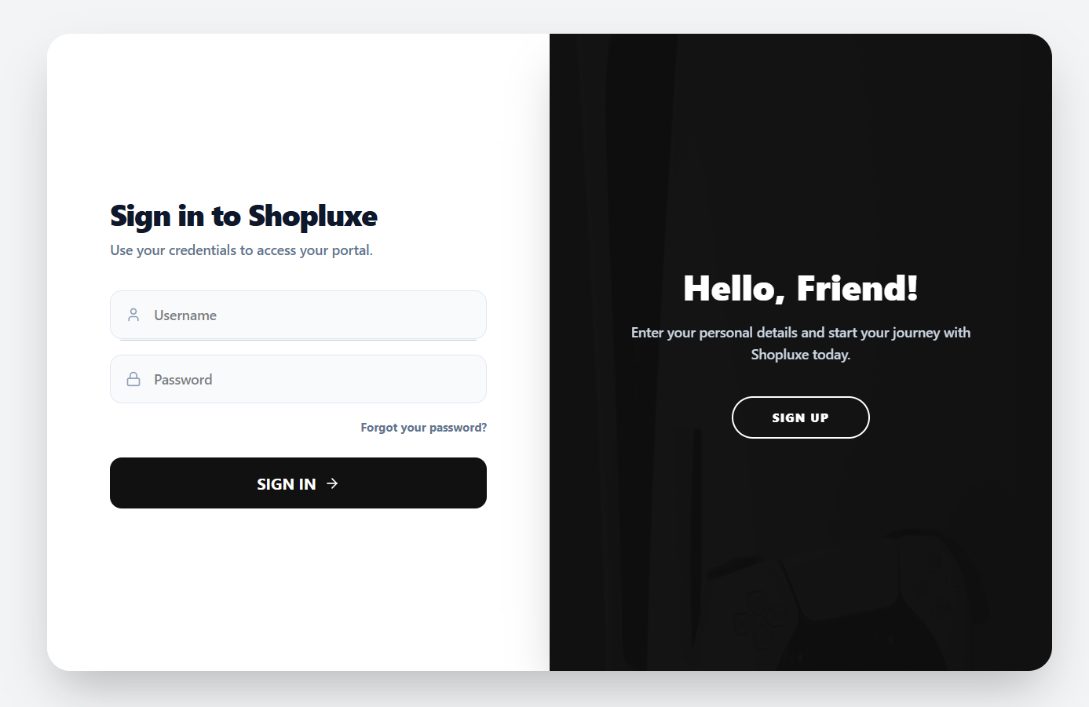
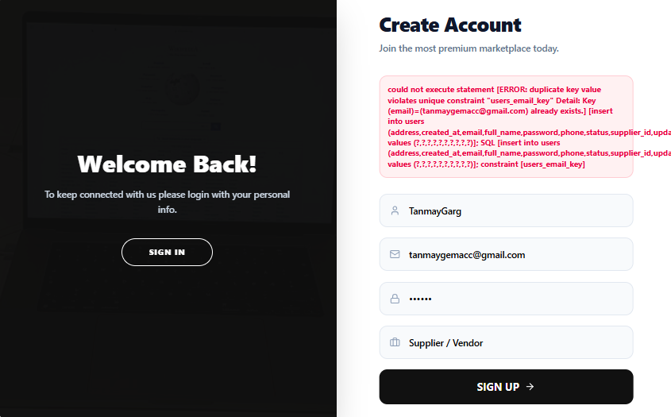
MODULE 01
Authentication & Access
Controls who may enter the system and what each user may do. The login page posts credentials to /api/auth/login; Spring Security checks the BCrypt hash and returns a JWT.
Registration: duplicate e-mail rejected
Sign-in page
Register as customer or supplier (FR-1.1)
Login with clear error messages (FR-1.2)
24-hour JWT as Bearer token (FR-1.3)
Role-based redirect to the right portal (FR-1.4)
Forgot password by e-mail; suspended accounts get HTTP 403
Sign-up window
Enter username, e-mail and password, then choose the account type: Customer or Supplier / Vendor. Duplicate usernames and e-mails are rejected, and the password is stored only as a BCrypt hash.
Retail Inventory Management System | Shopluxe
7

Slide 8
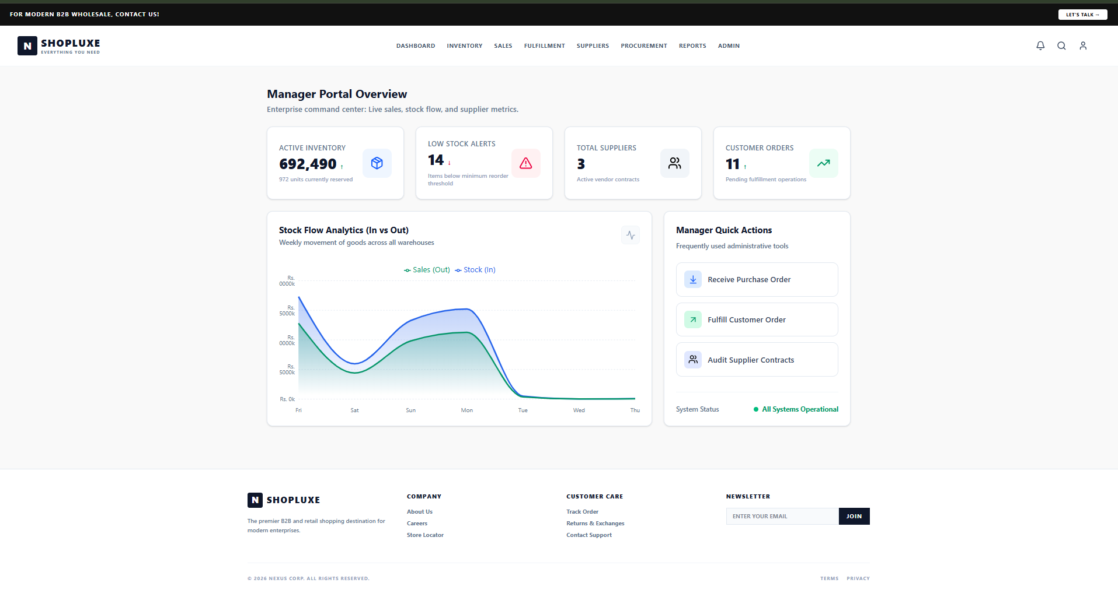
MODULE 02
Dashboard
Gives administrators a quick summary of business activity on login. It reads inventory, order and purchase data from the REST APIs and shows summary cards and Recharts charts.
Summary metric cards for stock, orders, suppliers (FR-2.1)
Stock Flow chart: sales out vs stock in (FR-2.2)
Low-stock alert count at a glance
Quick actions: receive PO, fulfill order, audit suppliers
Manager Portal Overview
692,490
14
3
11
Active inventory units
Low-stock alerts
Total suppliers
Customer orders
Retail Inventory Management System | Shopluxe
8

Slide 9
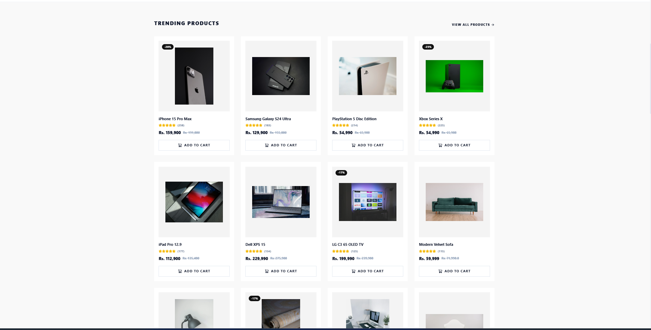
MODULE 03
Product Catalog
Maintains the master list of items the business sells. Every product has a unique SKU, name, category, description, cost and selling price, reorder level, status and image.
Add, edit and deactivate products; SKU must be unique (FR-3.1)
Category management (FR-3.2)
Search by name / SKU and filter by category (FR-3.3)
Reorder level drives low-stock alerts
Catalog as customers see it: prices, discounts and Add to Cart
PRODUCT RECORD
SKU | name | category | description | cost price | selling price | reorder level | status | image
Retail Inventory Management System | Shopluxe
9

Slide 10
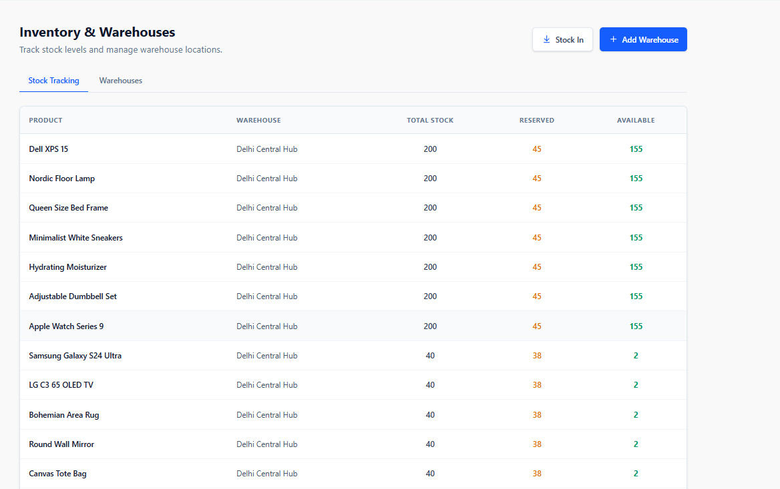
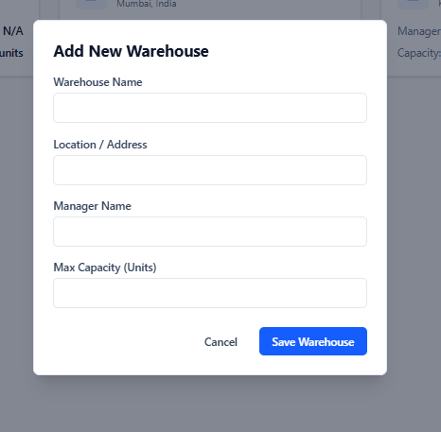
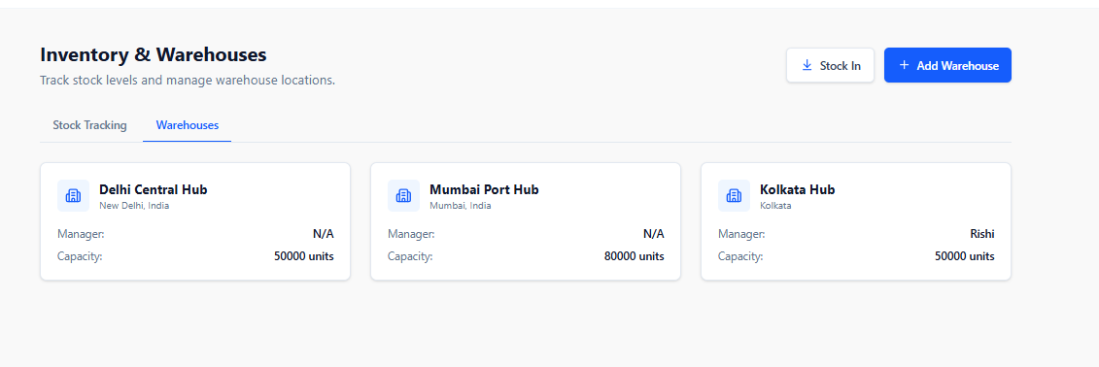
MODULE 04
Inventory & Warehouses
Shows how much of each product is held in each warehouse, with total, reserved and available quantity. Saving a record re-checks stock and raises a low-stock alert below the reorder level.
Stock Tracking: total, reserved, available
Add New Warehouse
Warehouse-wise stock view (FR-4.1)
Stock-in and adjustments; available quantity never negative (FR-4.2)
Add warehouses with manager and capacity (FR-4.3)
Stock transfer and transaction history (FR-4.4)
Warehouses tab: Delhi, Mumbai and Kolkata hubs with capacity
Retail Inventory Management System | Shopluxe
10

Slide 11
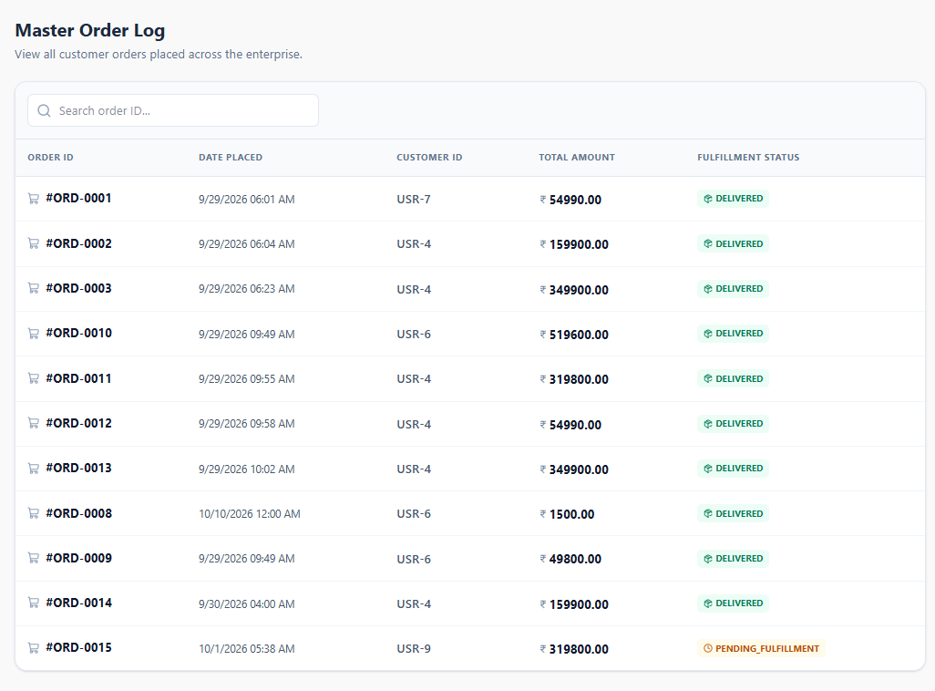
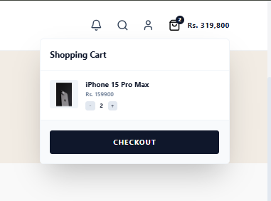
MODULE 05
ORDER STATUS
Orders
PENDING
CONFIRMED
PROCESSING
Captures customer orders and commits stock correctly. On order creation the service reduces available quantity and increases reserved quantity across the warehouses holding the product.
PACKED
SHIPPED
DELIVERED
Create order with items, quantity and price (FR-5.1)
Automatic stock reservation in one transaction (FR-5.2)
Low-stock alert if available < reorder level (FR-5.3)
Order Placed / New Order notifications (FR-5.4)
CANCELLED
Master Order Log (admin view of all orders)
From cart to reservation
Checkout creates the order, moves quantity from available to reserved, and notifies the creator and order managers.
Shopping cart
Retail Inventory Management System | Shopluxe
11

Slide 12
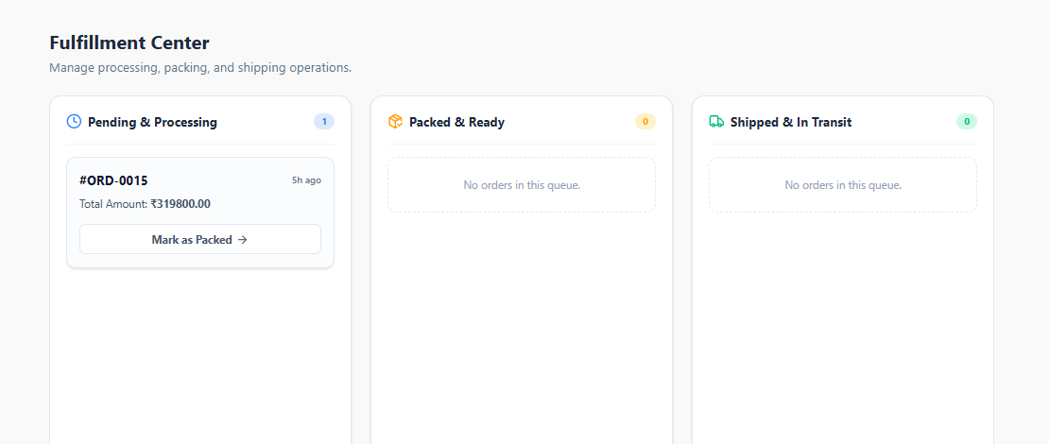
MODULE 06
Fulfillment
Moves an order from placement to delivery. The board groups orders by status and the admin advances them through PUT /api/orders/{id}/status.
Fulfillment Center: Pending, Packed and Shipped queues
Statuses: Pending, Confirmed, Processing, Packed, Shipped, Delivered, Cancelled (FR-6.1)
Mark as Packed moves a card to the next queue
Inventory finalized on ship / deliver (FR-6.2)
Creator notified on each change (FR-6.3)
Pending
Packed
Shipped
Delivered
Inventory finalization
On SHIPPED or DELIVERED, the reserved quantity is released and the total quantity is permanently reduced.
Retail Inventory Management System | Shopluxe
12

Slide 13
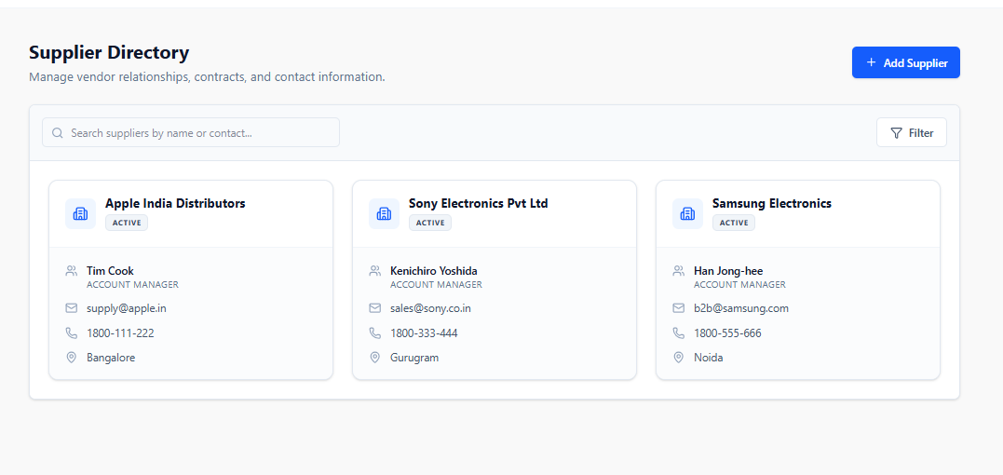
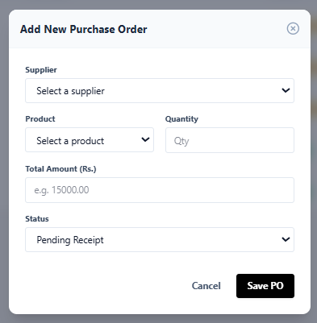
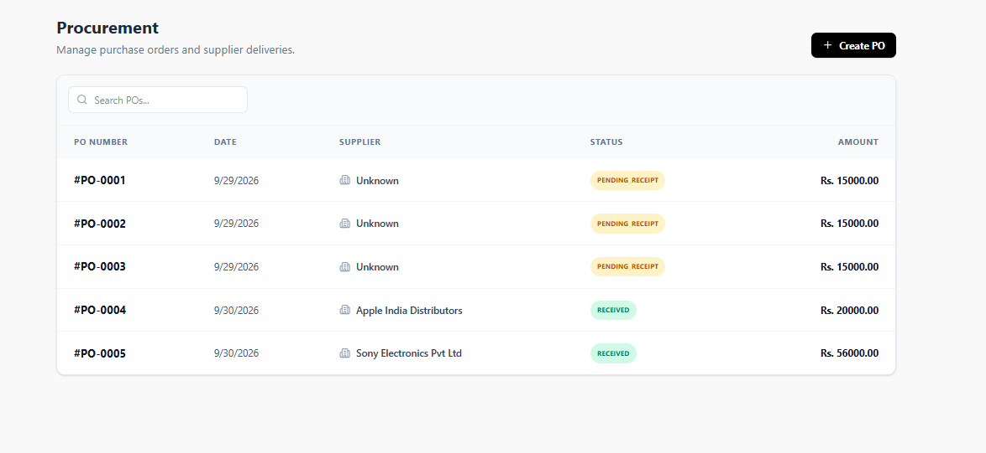
MODULE 07
Suppliers & Purchase Orders
Keeps a register of vendors and manages replenishment. A purchase order has product lines (quantity, unit cost, total) and moves from Pending to Received.
Supplier Directory
Create PO form
PO LIFECYCLE
Pending
Add, edit, view and delete suppliers (FR-7.1)
Create PO with items and total (FR-7.2)
Status tracking; supplier acceptance notifies procurement (FR-7.3)
Receiving a PO adds stock to inventory
Accepted
Shipped
Received
Procurement: PO list with status
Retail Inventory Management System | Shopluxe
13

Slide 14
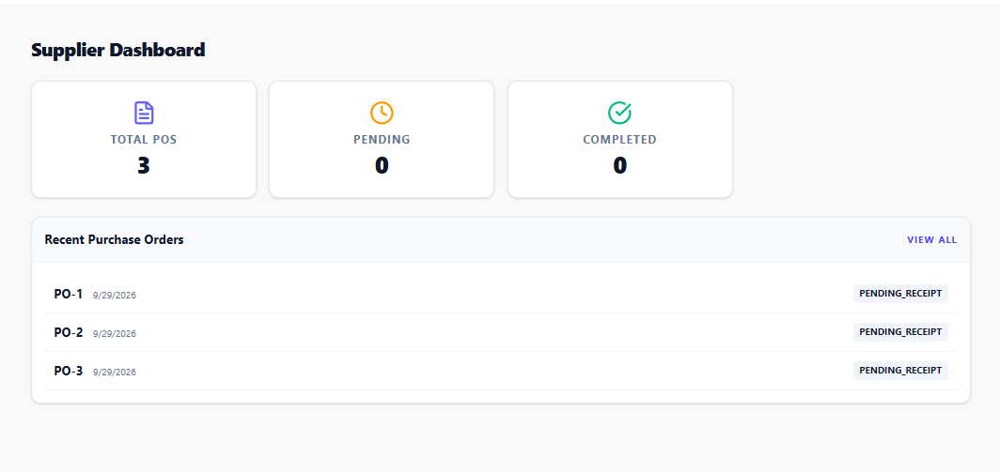
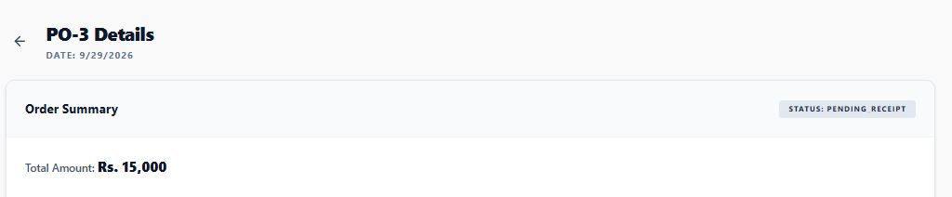
MODULE 08
Supplier Portal
Lets suppliers handle their own purchase orders without admin rights. After login, a ROLE_SUPPLIER user sees only the supplier dashboard and the POs assigned to them (/api/supplier).
View assigned purchase orders only (FR-8.1)
Update PO status, e.g. accept or ship (FR-8.2)
Edit item details of an assigned order (FR-8.3)
Dashboard counts: total, pending, completed
Supplier Dashboard with recent purchase orders
Purchase order detail: date, status and total amount
Retail Inventory Management System | Shopluxe
14

Slide 15
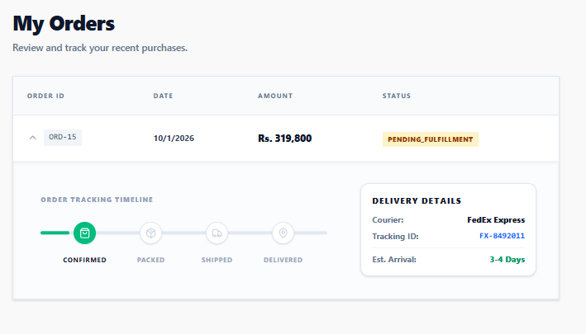
MODULE 09
Customer Portal
Provides the online shop front. Customers browse products by category or collection, add items to a cart, place orders and view their own history. Admin pages stay closed to them.
Cart and checkout
My Orders with tracking timeline
Browse and filter the catalog (FR-9.1)
Cart with quantity controls, then checkout (FR-9.2)
Order history shows only own orders (FR-9.3)
Expandable tracking: Confirmed, Packed, Shipped, Delivered
1 Browse
2 Add to cart
3 Place order
4 Track
Delivery details
Each order shows courier, tracking ID and estimated arrival next to its status timeline.
Retail Inventory Management System | Shopluxe
15

Slide 16
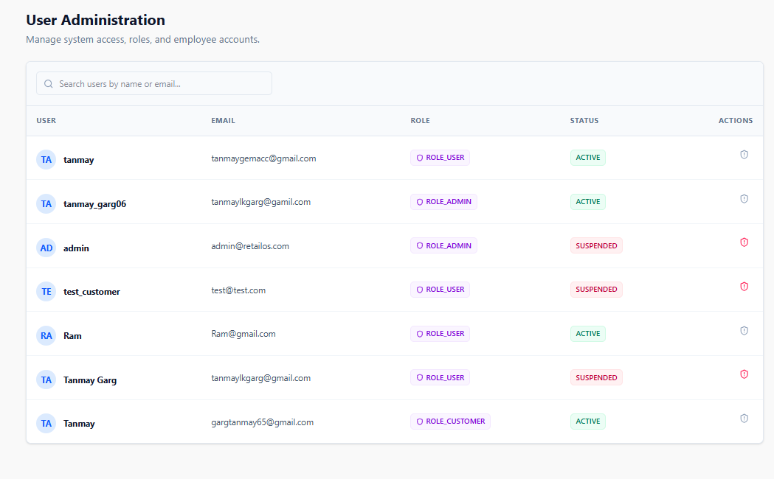
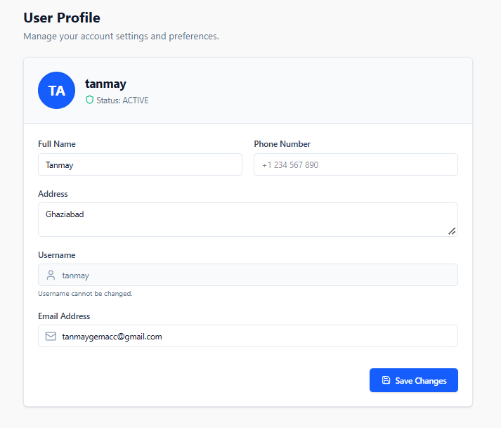
MODULE 10
Users & Profile
Administers accounts and lets users maintain their own details. Password hashes are never returned by the API.
User Administration (admin)
User Profile
Admin lists all users with role and status (FR-10.1)
Activate / suspend accounts; suspended users cannot log in (FR-10.2)
Users update name, e-mail, phone, address (FR-10.3)
Username is read-only after registration
Admin controls
Search by name or e-mail, view ROLE_ADMIN / ROLE_USER / ROLE_CUSTOMER, and toggle ACTIVE or SUSPENDED with one click.
Self-service
Every user edits their own profile; changes are saved to the users table via an authenticated call.
Retail Inventory Management System | Shopluxe
16

Slide 17
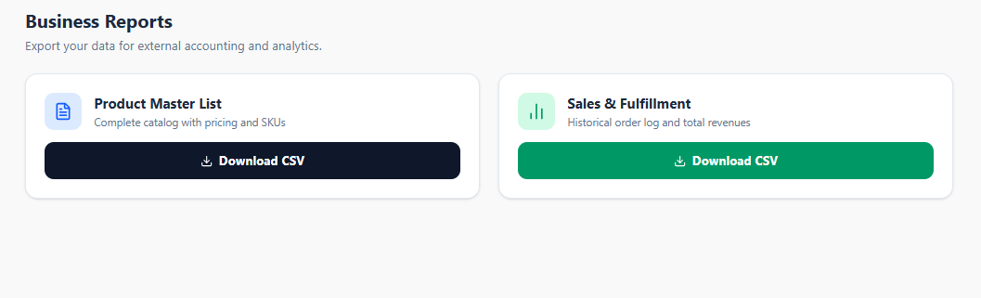
MODULE 11
Reports & Notifications
Supports monitoring and decisions. Two endpoints produce downloadable CSV files, and event notifications are stored per user and can be marked as read.
Business Reports: one-click CSV export
Inventory CSV: ID, SKU, name, category, prices (FR-11.1)
Sales CSV: order ID, date, status, total (FR-11.2)
Notifications per user, mark as read (FR-11.3)
Events: low stock, new order, status change, PO
GET /api/reports/inventory/csv
Downloads inventory_report.csv for accounting and analytics.
GET /api/reports/sales/csv
Downloads sales_report.csv with historical orders and revenue.
Low stock
New order
Status change
PO events
Retail Inventory Management System | Shopluxe
17

Slide 18
How the Modules Work Together
One shared database keeps every role looking at the same numbers.
1
2
3
4
5
6
Replenish
Receive
Sell
Reserve
Fulfill
Report
Admin raises a PO; supplier accepts it
PO marked Received; stock-in to a warehouse
Customer browses, fills cart, places order
Available goes down, reserved goes up; low-stock alert if needed
Pack, ship, deliver; reserved released, total reduced
Dashboard, CSV export, notifications
M7, M8
M4, M7
M3, M9
M5
M6
M2, M11
Automatic stock reservation runs inside a database transaction, and available quantity is protected by a CHECK constraint, so stock can never go negative.
Retail Inventory Management System | Shopluxe
18

Slide 19
Thank You
Retail Inventory Management System
Tanmay Garg | ABES Engineering College, Ghaziabad

